Slide 1


International Day of Yoga 21stJune, 2026
Presentation before the Committee of Secretaries February 2026
Ministry of Ayush Government of India

Slide 2


Origin of the International Day of Yoga
(IDY)
Hon’ble Prime Minister of India address to the United Nations General Assembly on September 27, 2014 to dedicate a day to celebrate Yoga.
On 11th December 2014, the United Nations General Assembly declared June 21st as the International Day of Yoga.

Slide 3
Since 2015, IDY has been observed annually on June 21st, Ministry of Ayush (MoA) the nodal Ministry. Other Ministries promote IDY activities within their respective domains, in a “Whole of Government Approach”
Events on 21st June in India
Common Yoga Protocol (CYP): 45 minutes duration curated activities
The Main Event of IDY: In India, the Prime Minister leads the event, preceded by his address.
Theme & Location: will be decided in due course
International Activities/ Events on 21st June:
      Countries around the world host yoga events, often in collaboration with Indian embassies and cultural centers.
Advance Mobilisation efforts
Taken up in a “100 Day Countdown” format, starting on 13th March, in collaboration with Yoga institutions and other stake-holders

Slide 4




IDY: Objectives
Good Health and Well-being – Sustainable Development Goal (SDG-3)
Branding India globally and making IDY an International event
Promoting awareness about physical, mental and spiritual benefits Yoga

Slide 5
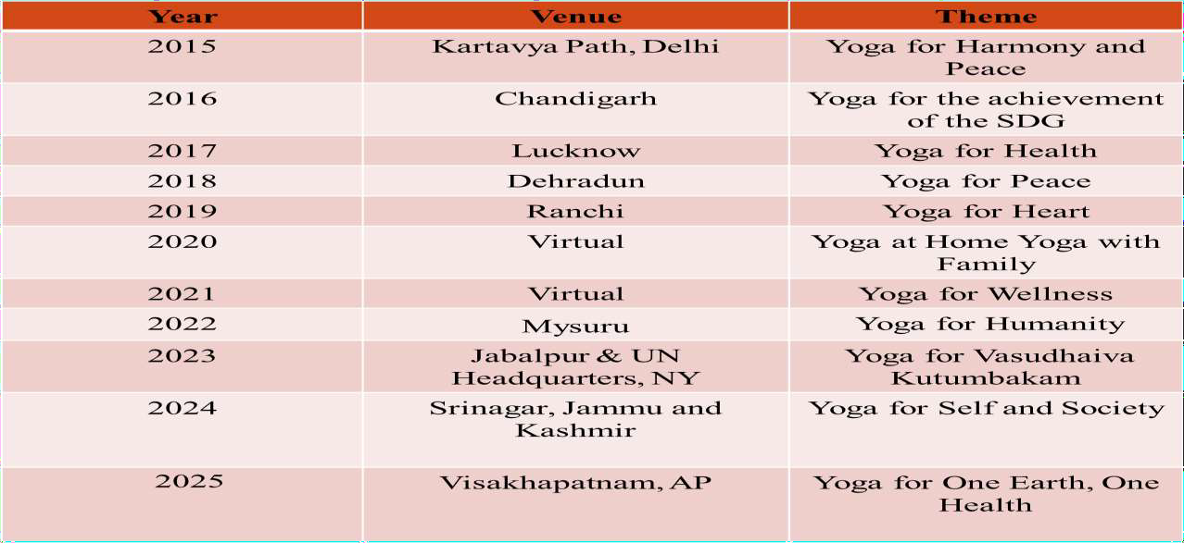
Previous International Days of Yoga (IDY)

Slide 6
Previous Initiatives
Two Guinness World Records achieved in 2015
Footfall of 35,985
from 84 Nationalities
My Life My Yoga video blogging contest
130 countries, with
44,000 entries.
Launch of Namaste Yoga, WHO m-Yoga Portals
2018
2021
2015
2020
2021
‘The Yoga Ambassadors’
Tour (2018)
Participants from 22
countries during 4th IDY.
Launch of Y-break initiative (2021) for Govt and Corporate Sector

Slide 7
Previous Initiatives –contd..
Yoga programmes, 100-day countdown 100 iconic locations
by 100 organizations
IDY at iconic locations globally - Opera House to Eiffel Tower to the Cathedral of Brasilia to the Dead Sea and base of Mount Everest
Common Yoga Protocol (CYP) training programmes
IDY celebration at 75
heritage/iconic sites
2022
2022
2022
2021–2022
2022
2022
Start-up Yoga
challenge
Surya Namaskar for Vitality: 75 Lakh people-Surya Namaskar on Makar Sankranti
Guardian Ring: 24 hr relay programme of IDY activities across the globe, linked with Hon’ble PM’s “One Sun One Earth campaign”

Slide 8
Previous Initiatives - contd..
Har Aangan Yoga Campaign: Yoga sessions from Panchayats, Anganwadi centers, and schools.
Yoga Sagarmala: Coastal demonstrations of yoga were termed "Yoga Sagarmala."
Yoga With Family Video Contest” – Through MyGov Portal and MyBharat portal
The Hon’ble Prime Minister Shri Narendra Modi led Yoga from the North Lawns at the United Nations Headquarters.
2023
2024
2023
2023
2023
The main national event of India was held at Jabalpur, Madhya Pradesh in the presence of Vice President Shri Jagdeep Dhankhar
Yoga Tech Challenge
Yoga Bharatmala The Indian Armed Forces demonstrations of yoga were termed “Yoga Bharatmala”
Yoga from Arctic to
Antarctica
“Ocean Ring” of Yoga: in this naval personnel from 19
ships across 34
countries participated.

Slide 9
Previous Initiatives – contd..
Significant events of IDY 2025
Yogasangama or Yog Sangam (Flagship Event)
Yoga Bandhan or the Bond of Yoga (Joint Yoga Programs)
Yoga Park Development
Yoga Samavesh
Yoga Prabhava: A Decadal Impact Assessment
Yoga Connect: A Virtual Global Yoga Summit
Harit Yoga (Sustainability Initiative)
Yoga Unplugged (Youth Initiatives)
Yoga Maha Kumbh
Samyogam

Slide 10
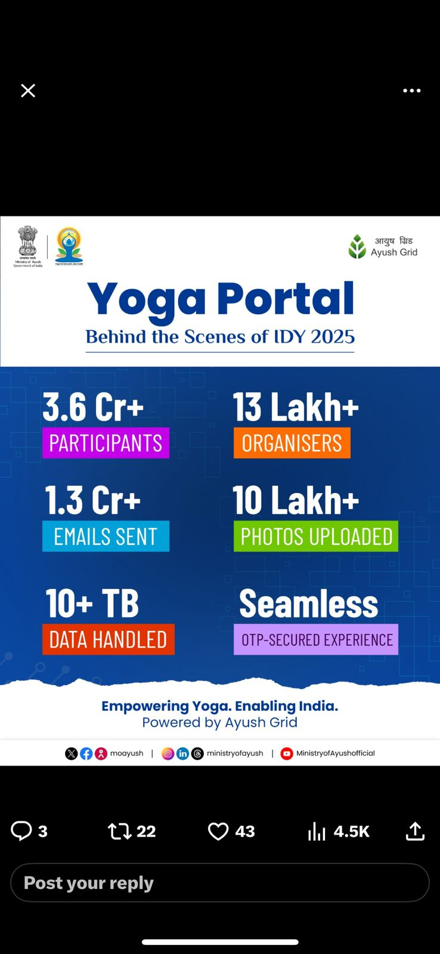
Significant Impact of IDY 2025
8.73+ Lakh Schools organized Yoga Sangam events
1,000+ Events launched from 13 March 2025
100 Days | 100 Cities | 100 Organizations across 31 States/UTs
340+ Yoga Samavesh (inclusive outreach)
40+ Samyoga Events (Yoga integration with healthcare & sectors)
320+ Harit Yoga Events promoting sustainability
100+ Youth-focused Yoga Unplugged Events
4 Mega Yoga Mahakumbh Events
130+ International Events in 60+ Countries
Yoga Bandhan: 17 International Guests | 20 Online | 1 Vietnam Event
Yoga Connect @ Vigyan Bhavan: 1,000+ in-person global participants
Yoga Prabhav: Decadal impact assessment of IDY presented
26.1 Cr+
Source: IDY 2025 report

Slide 11
IDY 2026
Planned Activities
Country-Wide Mobilization: Nationwide mobilization to undertake appropriate and specific activities for the observance of IDY.
Stakeholder Engagement: Central Ministries and Departments, State Governments, Yoga institutions, Educational Institutions, NCC, NSS, and NYKS will be sensitized on IDY and provided with customized activity lists aligned to their respective mandates.
Uniformed & Paramilitary Forces Participation: Efforts will be made to reach all uniformed and paramilitary units to ensure their active participation.
Review meetings: A series of meetings with Nodal Officers nominated by various Ministries/Departments of Government of India, States and UTs and their Social Media teams to ensure cohesion.
Core Organizing Committee meeting- meeting with Yoga stakeholders and the meeting of Inter-Ministerial Committee.

Slide 12
IDY 2026- contd..
Count-down to IDY activities: Ministry will launch a 100 day count-down campaign to
IDY. 100 days to IDY programs in 100 cities by 100 organizations/ chapters.
Event | Date | Place
100 days to IDY | 13th March, 2026
75 Days to IDY | 7th April, 2026
50 Days to IDY | 2nd May, 2026
25 Days to IDY | 27th May, 2026
Prime Minister's Awards for Yoga for 2026
The four awards are:
Prime Minister’s Awards for Yoga – Individuals (National & International):
2 awards
Prime Minister’s Awards for Yoga – Institutional (National & International):
2 awards
To be initiated through the Rashtriya Puraskar Portal.
Activities on MyGov platform: This Ministry has launched a variety of activities and programmes on MyGov platform so that people can engage digitally in our efforts to spread message of Yoga. The activities include IDY Quiz, Jingle Contest, IDY Pledge and Yoga with Family Video campaign, etc.

Slide 13
Goals for IDY 2026 Celebrations
Yoga for Global Well-Being and Peace: Extensive engagement of Indian Missions abroad and Foreign Embassies in India; envisaged as the world’s largest online yoga participation event on IDY 2026.
Yoga Unbound / Vibrant Village Yoga: Showcasing yoga’s accessibility and outreach to the remotest regions of the country.
Yoga Anusandhan & Chintan: A national-level conference on yoga research, policy, and integration with modern healthcare systems as part of IDY 2026 activities.
National Flagship Event – IDY 2026: Celebrations at an iconic national/heritage location in the august presence of Hon’ble leadership.
Pan-India Synchronised Participation: National event live-telecast and synchronised across all States and Union Territories.

Slide 14
Goals for IDY 2026 Celebrations-2
Simultaneous Demonstrations: Yoga demonstrations at 12 identified iconic/heritage locations across the country, as illustrated below.
Red Fort, Delhi | Mahabalipuram Shore Temple, Tamil Nadu
Statue of Unity, Kevadia, Gujarat | Sarnath, Uttar Pradesh
Konark Sun Temple, Odisha | Somnath Temple precincts, Gujarat
Hampi Group of Monuments, Karnataka | Charminar precincts, Hyderabad, Telangana
Khajuraho Group of Monuments, Madhya Pradesh | Gateway of India, Mumbai, Maharashtra
Nalanda Mahavihara, Bihar | Sabarmati Riverfront, Ahmedabad, Gujarat
Yoga Tech & Innovation Expo: Organized by the Central Council for Research in Yoga & Naturopathy (CCRYN), showcasing emerging technologies including AI-, AR-, and VR-enabled yoga solutions, smart yoga mats, wearable devices, and digital health innovations in the Ayush sector.
Yoga at Symbolic Spaces: A high-visibility initiative featuring yoga demonstrations at railway stations, airports, ports, and heritage sites in India and select international locations.

Slide 15
Stakeholder Engagement
Nodal Ministry: Ministry of Ayush || Stakeholder Ministries are:
Ministry of External
Affairs and ICCR
Ministry of Health &
Family Welfare
Ministry of
Education
Ministry of
Electronics & IT
Ministry of Communications-Department of Posts
Ministry of Defense
Ministry of Railways
Ministry of Information & Broadcasting
Ministry ofYouth
Affairs & Sports
Ministry of Culture
Ministry of Home
Affairs
Ministry of
Panchyati Raj
Ministry of Finance
Ministry of Women and Child Development (MWCD).
Ministry of Environment, Forest and Climate Change (MoEFCC)
Ministry of Development of North Eastern Region (MDoNER)

Slide 16
Partner Ministries: All other Ministries and Departments including Ministry of Rural Development, Ministry of Civil Aviation, Ministry of Road Transport and Highways, Ministry of Petroleum and Natural Gas, Ministry of Tribal Affairs, Ministry of Tourism, Ministry of Corporate Affairs will contribute within their domains, The Ministry of Labour & Employment, The Ministry of Ports, Shipping, and Waterways.
State-Level Support: State Governments, District Administrations and local bodies through Ayush Society, Directorate and Administration.
Stake holder Institutions: Yoga institutions, educational institutions, health and wellness institutions, youth organisations, Indian Yoga Association, Local Bodies, Universities etc.

Slide 17
Common Activities for Ministries/ Departments
Maximum participation in the main IDY event on 21st June 2026
Using social media platforms for dissemination of latest updates and information about IDY
Social Media posts of Ministry of Ayush may be shared by Ministries/Departments on their social media platforms
IDY logo may be displayed and IDY related guidelines/digital resources may be uploaded on the Websites/ Portals of respective Ministries/Departments.
Communication sent in this regard
Ministries/Departments may sensitize their employees on CYP/Y-break Pro

Slide 18




Common Activities for Ministries/Departments-2
Organizing Yoga-related activities such as online/offline lectures, workshops, seminar etc. by Yoga experts, ahead of IDY 2026
Publishing Yoga and IDY-specific articles in official e-
newsletter, bulletin, magazine etc
Employees may be encouraged for participation of their family members in the IDY activities organized on MyGov platform and MyBharat portal like quiz, competitions, video campaigns, etc.

Slide 19
Key Ministries – IDY 2026
M/o External Affairs
Global Coordination: Coordinate with foreign Governments/ Institutions/ Indian Missions for global observance of IDY 2026, including CYP training and event execution
Early Sensitization of Indian Missions: Through VCs, in coordination with the Ministry of Ayush, for timely planning, theme alignment, and standardized messaging. An Attempt to invite HoS/Spouse to gain more momentum this year.
Health Diplomacy: Institutionalize Yoga as a permanent pillar of India’s health diplomacy, leveraging the momentum of the WHO–Ministry of Ayush Global Summit on Traditional Medicine.
Leveraging MoUs and International Partnerships: Utilize existing MoUs with foreign governments, universities, and institutions to organize joint IDY events, conduct structured CYP training, and promote inclusion of Yoga modules.
Ayush Chairs and Academic Linkages: Facilitate Ayush Chairs abroad as IDY 2026 nodal points for academic seminars, workshops, demonstrations, student and faculty engagement, and documentation of best practices.

Slide 20
Key Ministries – IDY 2026
M/o External Affairs -2
Collaboration with Certified Yoga Institutions: Encourage Indian Missions to engage YCB-certified Yoga professionals and reputed institutions to ensure authenticity and adherence to the Common Yoga Protocol.
oEmbassy-Led Flagship Events: Promote high-visibility IDY events at iconic global locations in partnership with host governments, UN/WHO offices, and multilateral organizations for better execution.
oMultilateral and BRICS Engagement: Integrate Yoga promotion into UN, G20, and BRICS platforms, including promotion of IDY 2026 as a BRICS Wellness and Preventive Health Initiative.
oMedia and Digital Outreach: Support press briefings, social media campaigns, digital
outreach, and live streaming of IDY events by Indian Missions.
oYouth, Institutions, and Workplace Outreach: Encourage engagement of youth, schools, universities, and workplaces abroad through Yoga sessions, workshops, and awareness programs.
Documentation and Reporting: Ensure systematic documentation of events, participation, media coverage, and best practices, with post-event reports submitted to the Ministry of Ayush.

Slide 21


Department of Higher Education/ School Education & Literacy
Educational Institution Mobilisation: Mobilising educational institutions to promote Yoga awareness and IDY participation.
Student Volunteering: Encouraging student volunteering in IDY activities including CYP training, through NCC and NSS.
Yoga Olympiad may be planned (In collaboration with yogasana Bharat, a recognized federation for Yogasana Sport)

Slide 22
D/o Health & Family Welfare
Healthcare Network Mobilization: Leveraging the healthcare network from medical hospital and colleges to AAMs to raise awareness about Yoga's health benefits.
With the help of yoga expert of AAMs organize IDY event in the respective hospitals
Personnel Participation: Encouraging healthcare personnel (including Accredited Social Health Activist /Auxiliary Nurse Midwives) and their families to participate in IDY 2026 activities.
M/o Electronics and Information Technology
MyGov Portal Outreach: Utilising the MyGov portal for extensive online promotion of IDY 2026.
Portal and App Development: Developing digital tools to support various IDY activities.
Digital Media Promotion: Promoting IDY through online banners on government websites.

Slide 23
Department of Post
Postal Network Mobilisation: Utilising the postal network, especially in rural areas, for various IDY activities. (delivery of letter of Honourable Prime Minister to Panchayat heads)
IDY Branding on Postal Transactions
The International Day of Yoga (IDY) logo and theme of IDY 2026 as a digital and physical watermark on all postal receipts issued to the public. (counter receipts, speed post receipts, registered post acknowledgements, and e-receipts) during the IDY campaign period.
Community Engagement through Postal Staff
Postal employees and Gramin Dak Sevaks (GDS), as trusted community interfaces, to act as Yoga ambassadors at the grassroots level by disseminating information about IDY and motivating community participation.
Staff Participation: Encouraging staff and families to participate in IDY
through welfare and recreation channels.

Slide 24
Ministry of Defence
Uniformed Forces Mobilisation: Encouraging active participation of uniformed forces and paramilitary forces in IDY activities.
Family Participation: Encouraging family members of personnel to participate in IDY.
CYP Training and Demonstration: Conducting CYP training and demonstrations in Armed forces medical colleges, educational institutions, and field units.
Ministry of Railways
Yoga practice site on important Railway Stations on IDY for passengers waiting or visiting to Railway station.
Awareness Promotion through Railway Network: Using the railway network for IDY promotion through hoardings and videos at stations (inside train/ train schedule digital display board)
Employee and Family Participation: Encouraging employee and family participation in IDY.
Institutional Participation: Roping in educational and technical institutions affiliated with the Ministry for IDY participation.

Slide 25



Ministry of Information & Broadcasting
Media Channel Utilization: Utilizing print, electronic, and online media channels for disseminating information about IDY 2026 activities.
Local Media Engagement: Engaging local communities through AIR and DD programs, chat shows, and interactions with celebrities on Yoga and IDY.
Media Professional Workshop: Organising workshops for RJs and other
media professionals on IDY and CYP.
Telecast Support: Providing telecast support for the main IDY event
through Doordarshan channels.

Slide 26


Ministry of Youth Affairs & Sports
Infrastructure and Organizational Utilization: Leveraging the Ministry’s infrastructure, sports, and youth organizations for the nationwide IDY.
Sports Personality Engagement: Engaging prominent sports personalities to popularize Yoga and IDY activities, in the form of media byte.
Ministry of Culture
Organize simultaneous yoga demonstrations at iconic places of cultural and heritage importance in different parts of the country.
Cultural Event Organisation: Organising cultural events (dance/drama/songs) that showcase the importance of Yoga.
Institutional Involvement: Engaging major cultural institutions like the Sangeet Natak Academy in IDY 2026 celebrations.
Promotional Videos: Creating promotional videos featuring cultural icons and disseminating them through social media.

Slide 27

Ministry of Home affairs
1
2
Encouraging active participation of CAPFs and Para Military forces.
(IDY celebrations in all border districts or manned by border guarding forces covered under VVP)
Encouraging the family of all personnel of CAPFs to participate in IDY 2026 celebration.
Ministry of Panchayati Raj
Issue guidelines to all its institutions for their active
support in IDY 2026.
All public representatives of Panchayati Raj institutions may be requested to organize the program in their vicinity and ensure the participation of local public.

Slide 28
Ministry of Finance
IDY Watermark on Public Transaction Receipts issued by financial institutions :
All Ministries/Departments providing public services involving financial or service transactions may be encouraged to incorporate the IDY logo and theme as a digital watermark or message on:
  Payment receipts
  Service acknowledgements
  Online confirmations and SMS/email notifications
Citizen Touchpoint Strategy: This approach will ensure repeated, subtle, and non-intrusive exposure of IDY messaging to citizens in their day-to-day interactions with government services.

Slide 29
Ministry of Women and Child Development (MWCD)
Facilitate observance of Yoga sessions at Anganwadi Centres and community-level platforms, with a focus on women, adolescent girls, pregnant and lactating mothers, and children (Anganwadi Services & Poshan Abhiyaan)
Integrate Yoga-based wellness activities with POSHAN Abhiyaan
objectives to promote holistic nutrition, health, and well-being.
Encourage participation of Anganwadi Workers (AWWs) and beneficiaries
in IDY-related awareness and outreach programmes
Support dissemination of Yoga awareness materials aligned with maternal
and child health outcomes.

Slide 30



Ministry of Environment, Forest and Climate Change (MoEFCC)
Promote celebration of IDY 2026 in eco-sensitive locations, including parks,
botanical gardens, wetlands, forest campuses, and biodiversity sites.
Encourage nature-based Yoga activities highlighting the link between Yoga, environmental conservation, and sustainable lifestyles.
Facilitate participation of environmental institutions, field offices, and affiliated bodies in IDY programmes.
Support awareness campaigns on Yoga for harmony with nature and climate resilience, in alignment with national environmental objectives.

Slide 31
Ministry of Development of North Eastern Region (MDoNER)
Coordinate with North Eastern States for widespread observance of IDY 2026 across the region.
Facilitate organisation of Yoga programmes in remote, border tribal, and aspirational districts of the North Eastern Region.
Encourage participation of local communities, educational institutions, and youth groups in Yoga activities.
Support promotion of Yoga as a tool for community well-being, cultural integration, and regional outreach.

Slide 32
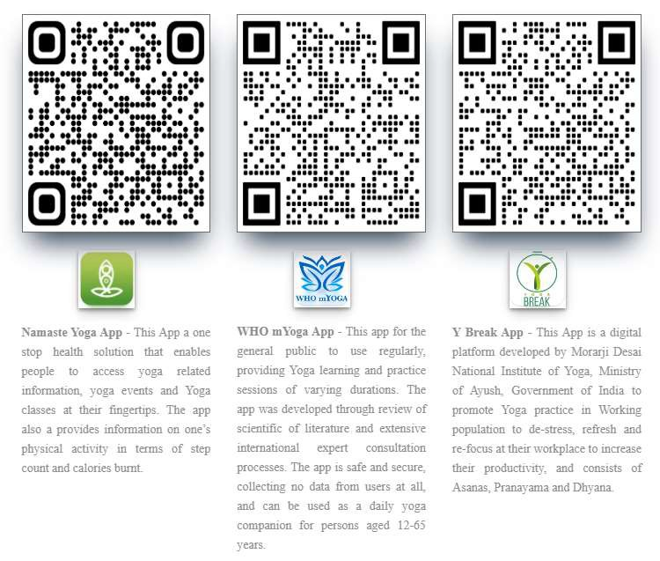

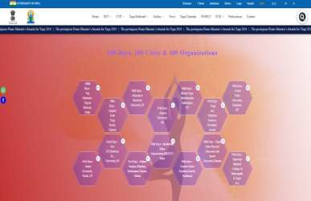
Digital assets of IDY
Yoga- Ayush Portal: Dynamic portal with all details, digital assets and latest information about IDY activities
39

Slide 33





